Slide 1
ADAPTIVE INTRUSION DETECTION FOR EVOLVING RPL ATTACKS
Controlled concept drift, Sybil identity attacks
and operationally grounded evaluation
AL-MIZAAN JAMAL
MSc Cybersecurity dissertation defence
Contiki-NG • Cooja • cross-attack transfer • whole-seed adaptation
30-minute defence presentation
Notes:
0:00-0:30. Introduce the dissertation as an empirical study of IDS behaviour when RPL attack mechanisms evolve. State that the work combines controlled Cooja attack implementations, cross-attack evaluation, supervised adaptation, online detection, an identity-based Sybil extension and isolated adaptive-controller experiments.

Slide 2
Problem, evidence and contribution
The dissertation asks whether an IDS trained in one RPL attack environment remains reliable when the mechanism changes.
Element
Question
Evidence produced
Generalisation
Does a static IDS transfer to a different attack family?
9 × 9 cross-attack matrix; 72 off-diagonal train/test pairs
Adaptation
How much target data recovers detection?
0-3 complete target seeds; held-out target-seed evaluation
New surface
Does identity manipulation behave differently?
Sybil baseline, low/high-rate campaign, identity monitoring
Online response
Can change be detected and acted upon?
CUSUM, DDM, incremental baselines, DQN/DDQN controllers
Operational validity
Do conclusions survive environmental change?
Relocation, lossy radio, trust analysis and defence cost
Central argument: adaptation helps only when the feature representation exposes the changed mechanism.
Research framing
02
Notes:
0:30-1:35. This is the organising logic for the presentation. Emphasise that the contribution is not simply implementing attacks. It is the linked evidence chain from protocol implementation to drift failure, adaptation, online response and operational limitations.
[Sources]
- /Users/mizzy/Dissertation_Cooja_Work/rpl-dis-flood/experiments/dissertation_results_summary_v1/core_argument.md
[/Sources]

Slide 3
RPL security context
RPL creates a rank-based routing graph toward a root; attacks target forwarding, control, route choice or identity.
Security surface
Implemented attacks
Protocol behaviour changed
Expected observables
Forwarding
Blackhole, grayhole
Drop all or selected application packets
Delivery, retransmission and response volume
Rank and route
Sinkhole, increase rank, worst parent, wormhole
Advertised rank, parent choice or radio path
Rank, parent churn and topology/radio evidence
Control plane
DIS flood, DIO suppression
Increase or suppress RPL control messages
DIS/DIO rates and timing
Identity
Sybil
Rotate IPv6 source identity in DIO traffic
Distinct identities, churn and consistency
Why Cooja
Executes Contiki-NG firmware logic, controls seed/topology/radio conditions, and preserves protocol-level logs. It provides simulator validity, not physical deployment validity.
Technical context
03
Notes:
1:35-2:50. Give the second examiner a concise RPL explanation. The root is the destination, rank expresses relative position, DIO and DIS are control messages, and nodes select parents. Then connect each attack to the observable evidence used by the IDS.
[Sources]
- /Users/mizzy/Dissertation_Cooja_Work/rpl-dis-flood/experiments/dissertation_results_summary_v1/attack_coverage_table.csv
[/Sources]

Slide 4
Relationship to SVELTE and Gope et al.
The prior papers shaped the security signals and adaptation question, but the experimental implementations differ.
Study
Environment
Security scope
Adaptive method
Role in this dissertation
SVELTE (2013)
Contiki/Cooja
RPL-aware sinkhole and selective forwarding detection
Hybrid routing and intrusion evidence
Motivates protocol-specific features and Cooja validation
Gope et al. (2022)
NetSim
Multiple evolving RPL/6LoWPAN attack profiles
Adversarial RL; DQN/DDQN; DDM
Motivates drift, adaptation and adversarial profile selection
This work
Contiki-NG/Cooja
Nine validated attack families plus Sybil rate variation
Static transfer; whole-seed retraining; online and isolated RL studies
Controlled firmware-level extension with leakage-aware evaluation
Claim boundary: extension and empirical comparison, not an exact reproduction of the NetSim ARL architecture.
Literature positioning
04
Notes:
2:50-4:10. SVELTE motivates using RPL-aware routing evidence. Gope et al. motivates an evolving environment, change detection and adaptive defenders. Our design chooses Cooja and whole-seed experiments to expose firmware behaviour and reduce leakage. It does not claim that a CART or local controller replaces the paper's complete architecture.
[Sources]
- /Users/mizzy/Downloads/2013-Elsevier-SVELTE realtime ID in the IoT.pdf
- /Users/mizzy/Documents/Dissertation/diss papers/Adversarial_RL-Based_IDS_for_Evolving_Data_Environment_in_6LoWPAN.pdf
[/Sources]

Slide 5
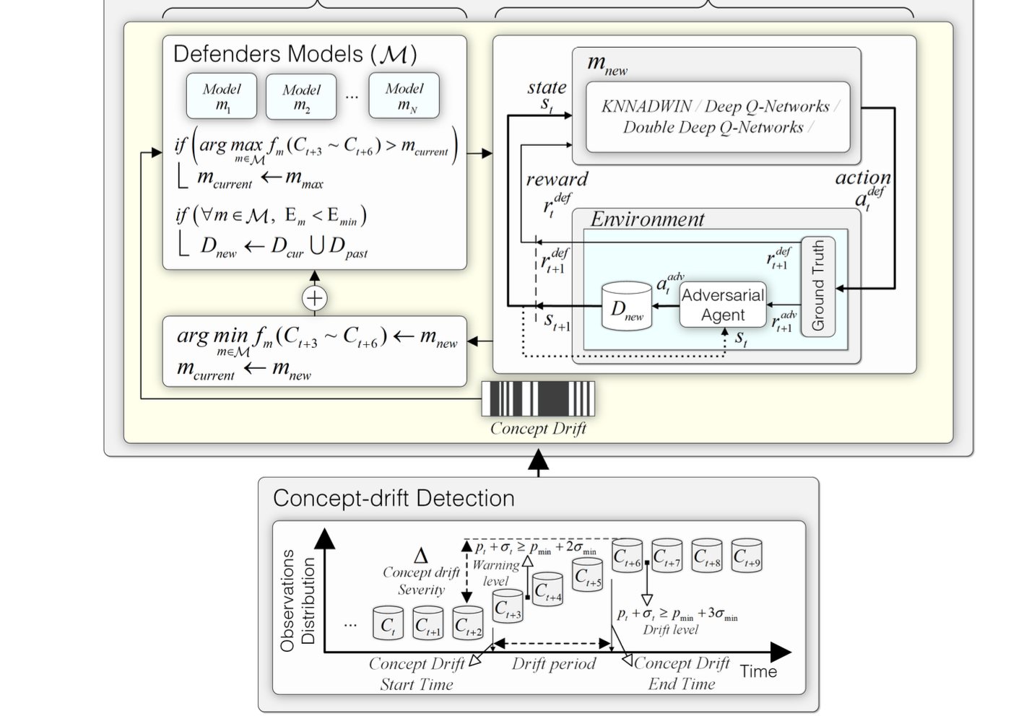
NetSim versus Cooja
The choice changes what can be controlled, inspected and claimed.
Criterion
NetSim route
Cooja route
Scale and scenario design
Strong for network-level profiles
Smaller campaigns; detailed firmware execution
Protocol implementation
Model configuration
Real Contiki-NG application and RPL hook code
Inspection
Aggregate simulator evidence
Attack markers, routing logs and radio traces
Reproducibility risk
Simulator and model configuration
Contiki version, Cooja configuration and build state
Gope et al. architecture
Validity limit
Abstracted implementation behaviour
No physical radio/hardware deployment
The methods are complementary. Cooja provides implementation fidelity; NetSim supports the paper's larger adaptive architecture.
Method comparison
05
Notes:
4:10-5:20. Explain the trade-off rather than presenting Cooja as universally better. The paper's NetSim approach is appropriate for adversarial RL profiles and large scenario control. Cooja is appropriate for demonstrating that the attack code, RPL hooks and logs execute in Contiki-NG.
[Sources]
- /Users/mizzy/Documents/Dissertation/diss papers/Adversarial_RL-Based_IDS_for_Evolving_Data_Environment_in_6LoWPAN.pdf
- /Users/mizzy/Dissertation_Cooja_Work/rpl-dis-flood/experiments/dissertation_overleaf_v1/chapters/03_methodology.tex
[/Sources]

Slide 6
Experimental protocol
Each family uses matched attack/control seeds and a delayed activation point.
Parameter
Value
Purpose
Topology
16 nodes; attack node 16 in baseline
Comparable routing environment across families
Simulation duration
540 simulated seconds
Captures pre-attack and post-attack behaviour
Attack activation
240 seconds
Separates normal warm-up from attack period
Seeds
123456, 234567, 345678, 456789, 567890
Five independent matched repetitions
Per-family baseline
5 attack + 5 control runs
Balanced condition-level validation
Feature window
60 seconds
Temporal observations for drift and adaptation
Split unit
Complete simulation seed/run
Prevents windows from one run crossing train and test
Methodology
06
Notes:
5:20-6:25. Explain the activation and matched-control structure. Highlight that the split unit is the entire simulation seed. Randomly splitting rows would leak temporally related windows from the same run and inflate performance.
[Sources]
- /Users/mizzy/Dissertation_Cooja_Work/rpl-dis-flood/experiments/final_simulated_dataset_v1/evaluation_protocol.md
[/Sources]

Slide 7
Attack implementation and validation evidence
Ninety baseline Cooja runs were validated before any cross-attack IDS claim was made.
Attack
Mechanism
Attack
Control
Observed attack evidence
Status
Blackhole
Drop forwarding
5
5
Post-activation responses suppressed to 0-3
Validated
Sinkhole
Advertise minimum rank
5
5
1 advertised-rank event per attack run
Validated
DIS flood
Flood DIS
5
5
149 effect events per run
Validated
Grayhole
Selective drop
5
5
208-211 effect events per run
Validated
Increase rank
Degrade advertised rank
5
5
1-2 effect events per run
Validated
DIO suppression
Suppress DIO
5
5
1-2 effect events per run
Validated
Worst parent
Malicious parent choice
5
5
2630-3593 effect events per run
Validated
Wormhole
Directed radio tunnel
5
5
1706-1725 tunnel events per run
Validated
Sybil
Rotate DIO identity
5
5
150-151 spoofed identity events per run
Validated
Baseline total: 45 attack + 45 matched control simulations
Implementation validation
07
Notes:
6:25-7:30. This is the validation evidence behind the attack-coverage claim. Do not spend equal time on every row. Point out the different evidence mechanisms, then emphasise that Sybil produces direct virtual-identity DIO markers while controls produce none.
[Sources]
- /Users/mizzy/Dissertation_Cooja_Work/rpl-dis-flood/experiments/dissertation_results_summary_v1/attack_coverage_table.csv
[/Sources]

Slide 8
Frozen dataset and provenance controls
The dataset is generated from validated runs and keeps validation metadata separate from predictive evidence.
810
90
84
57
60-second windows
run groups
total columns
generic predictive features
Column group
Included in model?
Examples and purpose
Predictive network features
Yes
Delivery, radio, routing-state, parent and identity evidence
Run provenance
No
Family, seed, attack/control mode and source file
Attack markers
No
Ground-truth activation and mechanism validation
Labels
Target only
Normal versus post-activation attack windows
Sixteen marker/provenance fields are excluded from predictors. Whole-seed grouping is retained through every evaluation.
Dataset construction
08
Notes:
7:30-8:35. The frozen dataset contains 810 windows across 90 baseline run groups. Explain that provenance is necessary for auditability but cannot be a predictive shortcut. Attack markers identify activation and validate the implementation, but they are not features.
[Sources]
- /Users/mizzy/Dissertation_Cooja_Work/rpl-dis-flood/experiments/final_simulated_dataset_v1/evaluation_protocol.md
- /Users/mizzy/Dissertation_Cooja_Work/rpl-dis-flood/experiments/final_simulated_dataset_v1
[/Sources]

Slide 9
IDS evaluation stack
Different models answer different questions; they are not treated as interchangeable.
Component
Models
Evaluation mode
Question answered
Static baseline
CART; Gaussian
Cross-family train/test transfer
Does a fixed representation generalise?
Supervised adaptation
CART + 0-3 target seeds
Held-out whole target seeds
How much labelled target data restores performance?
Online baselines
Gaussian update; River NB; Hoeffding tree
Prequential stream evaluation
Can incremental learning respond without batch retraining?
Change detection
CUSUM; DDM
Held-out post-activation stream
When should adaptation be triggered?
Adaptive controller
DQN and DDQN
Isolated held-out Sybil stream
Can a learned policy choose adaptation actions?
Identity monitor
Rule-based consistency signal
Post-activation Sybil/control windows
Does an identity-specific observable expose Sybil directly?
Models
09
Notes:
8:35-9:45. Distinguish the main dissertation result from the isolated adaptive package. CART cross-attack and whole-seed adaptation are the strongest broad evidence. The online and DQN/DDQN experiments are narrower Sybil-focused extensions and must be reported with that boundary.
[Sources]
- /Users/mizzy/Dissertation_Cooja_Work/rpl-dis-flood/experiments/adversarial_rl_sybil_v1/README.md
- /Users/mizzy/Dissertation_Cooja_Work/rpl-dis-flood/experiments/dissertation_results_summary_v1/results_summary.md
[/Sources]

Slide 10
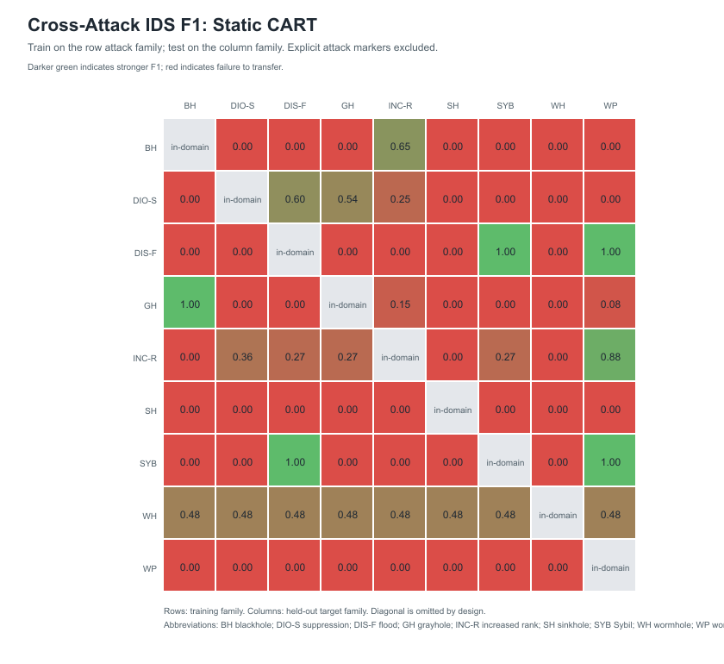
Static cross-attack transfer matrix
CART is trained on one attack/control environment and evaluated on a different held-out family.
48 / 72
cross-attack pairs with zero recall
6 / 72
pairs with F1 ≥ 0.80
0.182
mean cross-attack F1
Concept drift result
10
Notes:
9:45-11:15. Show how to read one cell. Rows are source attack families and columns are different target families. Forty-eight of 72 off-diagonal CART pairings miss every attack window. Only six reach F1 at least 0.8. This is controlled attack-distribution drift rather than naturally observed field drift.
[Sources]
- /Users/mizzy/Dissertation_Cooja_Work/rpl-dis-flood/experiments/dissertation_final_figures_v2/tables/cross_attack_cart_f1.csv
- /Users/mizzy/Dissertation_Cooja_Work/rpl-dis-flood/experiments/dissertation_results_summary_v1/concept_drift_key_metrics.csv
[/Sources]

Slide 11
Static models agree on the failure, not its severity
The weaker Gaussian baseline shows that model choice does not remove the representation problem.
CART
Gaussian
Metric
Result
Mean recall
0.23
0.07
CART zero recall
48 / 72
Gaussian zero recall
66 / 72
Mean F1
0.18
0.04
CART mean F1
0.1822
Gaussian mean F1
0.0362
Strong F1 pairs / 72
0.08
0.00
Interpretation
failure persists
0.00
0.25
0.50
0.75
1.00
Accuracy alone is misleading on windowed data because pre-attack and control windows dominate the normal class.
Model comparison
11
Notes:
11:15-12:15. CART is stronger than Gaussian, but both transfer poorly. Explain why recall and F1 matter more than accuracy: a model can predict normal for every row and still obtain apparently acceptable accuracy when normal windows dominate.
[Sources]
- /Users/mizzy/Dissertation_Cooja_Work/rpl-dis-flood/experiments/dissertation_results_summary_v1/concept_drift_key_metrics.csv
[/Sources]

Slide 12
Feature representation changed the sinkhole conclusion
The early coarse result failed; routing-state evidence made supervised adaptation possible.
Blackhole → sinkhole condition
Seeds
Recall
F1
Interpretation
Static coarse windows
0
0.000
0.000
All attack windows missed
Coarse adaptation
3
0.060
0.098
Retraining still lacks rank evidence
Routing-aware adaptation
1
0.730
0.813
Low-rank advertisement becomes learnable
Routing-aware adaptation
2
0.873
0.909
Further recovery
Routing-aware adaptation
3
0.950
0.973
High recall with FPR 0
Failure analysis changed the method: the representation was extended before making a general adaptation claim.
Feature ablation
12
Notes:
12:15-13:35. This is a central methodological learning. The original blackhole-to-sinkhole experiment produced zero recall. Simply adding sinkhole examples to coarse traffic features did not solve it. Once persistent advertised-rank and routing-state evidence was included, one to three whole target seeds produced F1 from 0.813 to 0.973. This directly supports the feature-plus-adaptation argument.
[Sources]
- /Users/mizzy/Dissertation_Cooja_Work/rpl-dis-flood/experiments/results/master_results_summary.csv
- /Users/mizzy/Dissertation_Cooja_Work/rpl-dis-flood/experiments/routing_features_v1/results/RESULTS_INTERPRETATION.md
[/Sources]

Slide 13
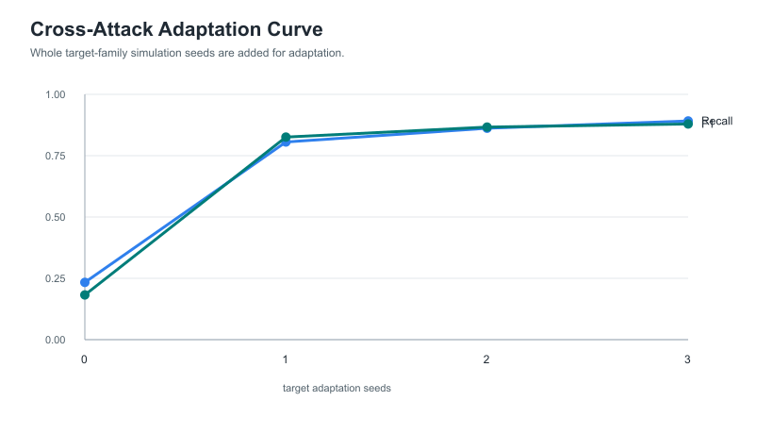
Whole-seed adaptation curve across nine families
Target-family runs are added to training, while evaluation remains on unseen target seeds.
Seeds
Recall
F1
FPR
0
0.233
0.182
0.112
1
0.806
0.826
0.021
2
0.862
0.866
0.027
3
0.892
0.879
0.030
Largest recovery occurs after the first complete target seed.
Adaptation result
13
Notes:
13:35-14:55. The overall mean F1 rises from 0.1822 to 0.8258 after one target seed, then to 0.8792 after three. Point out the small FPR increase after additional seeds. The curve supports rapid supervised recovery on average, but the next slide shows that family-specific outcomes are not monotonic.
[Sources]
- /Users/mizzy/Dissertation_Cooja_Work/rpl-dis-flood/experiments/dissertation_results_summary_v1/adaptation_key_metrics.csv
[/Sources]

Slide 14
Adaptation is heterogeneous across attack pairs
Mean recovery does not imply every source-target pairing improves monotonically.
Source → target
Static F1
1 seed
2 seeds
3 seeds
Observed pattern
Blackhole → DIS flood
0.000
1.000
1.000
1.000
Immediate clean recovery
Blackhole → sinkhole
0.000
0.571
0.966
0.947
Two seeds outperform one and three
Blackhole → wormhole
0.000
0.778
0.692
0.727
Non-monotonic
DIO suppression → Sybil
0.000
0.889
0.846
0.750
More target data reduces this pairing
DIS flood → DIO suppression
0.000
0.000
0.000
0.000
Representation remains insufficient
Grayhole → blackhole
1.000
1.000
1.000
1.000
Mechanism similarity transfers
The correct claim is average recovery with unresolved pair-specific failures, not universal convergence.
Adaptation detail
14
Notes:
14:55-16:10. Use this table to avoid overclaiming the overall adaptation curve. Some pairs recover immediately, some are non-monotonic, and DIS flood to DIO suppression remains undetected despite target examples. This points to limited samples, model instability and missing mechanism-specific evidence.
[Sources]
- /Users/mizzy/Dissertation_Cooja_Work/rpl-dis-flood/experiments/cross_attack_adaptation_with_sybil_v1/cross_attack_adaptation_summary.csv
[/Sources]

Slide 15
Why Sybil is a meaningful new attack surface
One physical node creates multiple apparent RPL identities, changing the observable from forwarding or rank to identity consistency.
Dimension
Existing attack examples
Sybil mechanism
Why it matters for drift
Primary surface
Packet forwarding; rank; control rate
IPv6 source identity in outgoing DIO messages
Out-of-family representation shift
Trust implication
One neighbour accumulates history
Each virtual identity can appear new
Forwarding-only trust can be reset or diluted
Implementation
Shared flag and delayed activation
Rotating virtual source identities after 240 s
Direct protocol marker and rate control
Baseline evidence
Family-specific attack markers
150-151 spoofed DIO markers per run
Five attacks positive; five controls zero
Novelty boundary
Known Sybil concept
New implementation/evaluation within this project
Not claimed as invention of Sybil itself
Contribution: a new identity-manipulation attack surface in the dissertation's controlled Cooja and adaptation framework.
Sybil contribution
15
Notes:
16:10-17:30. Give the detailed explanation. Sybil is selected because it is mechanism-distinct, not because it is simply an additional attack. It challenges identity continuity and trust bootstrapping, supplies an out-of-family drift target, and supports rate variation. The novelty claim is the implementation and evaluation in this framework, not invention of the Sybil attack.
[Sources]
- /Users/mizzy/Dissertation_Cooja_Work/rpl-dis-flood/experiments/sybil_attack_v1/README.md
- /Users/mizzy/Dissertation_Cooja_Work/rpl-dis-flood/experiments/dissertation_results_summary_v1/sybil_contribution_summary.md
[/Sources]

Slide 16
Sybil rate campaign: sensitivity beyond one attack setting
Five seeds were run for low rate, high rate and matched control conditions.
Condition
Runs
Spoofed DIO / run
Node 16 TX after 240 s
Total radio TX, mean
Control
5
0
1,676-1,699
8,984
Low-rate Sybil
5
29
1,707-1,736
9,020
High-rate Sybil
5
299
1,986-1,997
9,301
Spoofed DIO markers
Control
0
Low rate
29
High rate
299
0
80
160
240
320
Higher attack rate is directly observable, but it also changes radio load and may be easier to detect.
Sybil experiment
16
Notes:
17:30-18:35. The low-rate profile sends 29 spoofed identity markers, while the high-rate profile sends 299. High rate also increases node 16 and total radio transmissions. This creates a useful adversarial trade-off: aggressive behaviour has greater impact but a stronger signature.
[Sources]
- /Users/mizzy/Dissertation_Cooja_Work/rpl-dis-flood/experiments/adversarial_rl_sybil_v1/results/sybil_rate_campaign_metrics.csv
[/Sources]

Slide 17
Sybil detection and adaptation evidence
Identity-specific evidence is strong; generic cross-attack transfer remains weak without target data.
Evaluation
Precision
Recall
F1
Interpretation
Sybil target, static CART
0.216
0.275
0.218
Poor cross-family transfer
Sybil target, 1 seed
1.000
0.944
0.968
Large held-out recovery
Sybil target, 3 seeds
1.000
0.950
0.969
Stable high performance
Identity monitor, attack
1.000
1.000
1.000
50/50 post-activation windows alerted
Identity monitor, control
n/a
n/a
n/a
0/45 control windows alerted
11 / 16
0.968
50 / 50
Sybil-related static pairs with zero recall
F1 after one complete Sybil seed
identity-monitor attack windows alerted
Sybil result
17
Notes:
18:35-19:50. Separate the generic IDS and identity monitor. Static models involving Sybil have 11 zero-recall failures out of 16 pairings. Supervised adaptation recovers strongly. The identity-specific monitor detects all 50 post-activation windows with zero alerts in 45 controls, but this is a rule-based mechanism-specific result on a small controlled campaign.
[Sources]
- /Users/mizzy/Dissertation_Cooja_Work/rpl-dis-flood/experiments/dissertation_results_summary_v1/adaptation_key_metrics.csv
- /Users/mizzy/Dissertation_Cooja_Work/rpl-dis-flood/experiments/adversarial_rl_sybil_v1/results/sybil_identity_monitor_summary.csv
[/Sources]

Slide 18
Adaptive-controller extension: useful but not yet superior
The isolated DQN/DDQN experiment tests policy-controlled updating on 72 held-out Sybil stream windows.
Policy / algorithm
Accuracy
Precision
Recall
F1
Finding
Static source / DQN
0.722
0.000
0.000
0.000
All 20 attacks missed
Always incremental / DQN
0.861
1.000
0.500
0.667
Best DQN policy
RL controller / DQN
0.778
1.000
0.200
0.333
Under-updates
Static source / DDQN
0.722
0.000
0.000
0.000
All 20 attacks missed
Always incremental / DDQN
0.861
1.000
0.500
0.667
Best DDQN policy
RL controller / DDQN
0.833
1.000
0.400
0.571
Improves on DQN controller
The learned controller does not beat always-incremental updating. This is an extension result and a limitation, not evidence of RL superiority.
Adaptive IDS extension
18
Notes:
19:50-21:05. This slide corrects the omission in the first deck. The DQN and DDQN controllers were implemented locally and evaluated on a held-out Sybil stream. DDQN improves over the DQN controller, but both remain below always-incremental updating. The result is scientifically useful because it prevents an unjustified claim that RL automatically improves adaptation.
[Sources]
- /Users/mizzy/Dissertation_Cooja_Work/rpl-dis-flood/experiments/adversarial_rl_sybil_v1/results/adversarial_rl/held_out_summary.csv
- /Users/mizzy/Dissertation_Cooja_Work/rpl-dis-flood/experiments/adversarial_rl_sybil_v1/docs/model_scope.md
[/Sources]

Slide 19
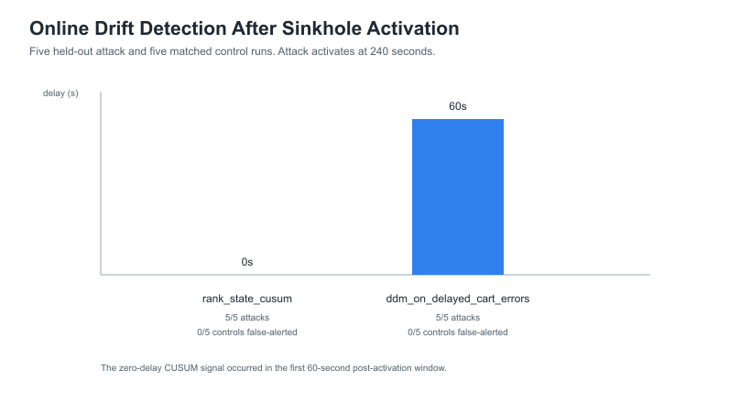
Online drift detection: trigger timing matters
Mechanism-aware CUSUM reacts earlier than delayed classifier-error monitoring.
Detector
Result
CUSUM attack
5 / 5
CUSUM control
0 / 5 alerts
CUSUM delay
0 s window
DDM attack
5 / 5
DDM control
0 / 5 alerts
DDM delay
60 s
Five-seed controlled result
Online response
19
Notes:
21:05-22:00. CUSUM operates on the rank-state signal and alerts in the first post-activation window. DDM waits for delayed classifier errors and alerts one 60-second window later. The sample is five attack and five matched control runs, so the zero false-alert rate is not a field estimate.
[Sources]
- /Users/mizzy/Dissertation_Cooja_Work/rpl-dis-flood/experiments/online_drift_response_v1/results/detector_comparison_summary.csv
[/Sources]

Slide 20
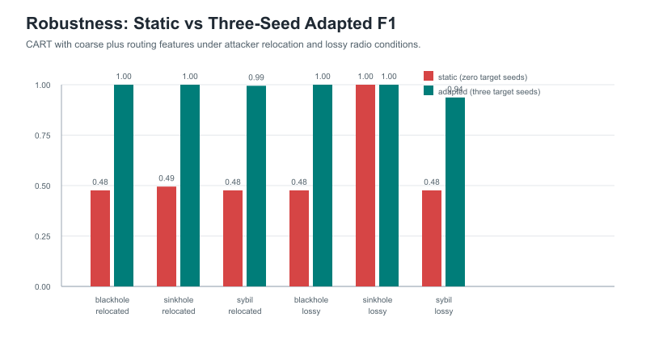
Robustness under attacker relocation and lossy radio
Sixty additional runs test whether adaptation depends on the baseline position and radio model.
Condition
3-seed F1
BH relocated
1.000
SH relocated
1.000
Sybil relocated
0.995
BH lossy
1.000
SH lossy
1.000
Sybil lossy
0.937
Lossy Sybil FPR = 0.046
Robustness
20
Notes:
22:00-23:00. Three-seed adaptation remains high under relocation and lossy radio. Lossy-radio Sybil is the weakest case at F1 0.9367 and FPR 0.0462. This supports limited simulator robustness, not physical deployment generalisation.
[Sources]
- /Users/mizzy/Dissertation_Cooja_Work/rpl-dis-flood/experiments/dissertation_final_figures_v2/tables/robustness_static_vs_adapted.csv
[/Sources]

Slide 21
Trust features and active defence produced negative results
Interpretability improved, but predictive metrics and network operation did not.
Trust-layer evaluation
Baseline F1
Trust F1
Change
Sinkhole condition
App responses
Radio TX
Static cross-attack
0.1822
0.1822
0.0000
Control
417.4
5,217
1-seed adaptation
0.8258
0.8258
0.0000
Attack
416.6
5,243
2-seed adaptation
0.8664
0.8664
0.0000
Rank-parent defence
87.4
35,020
3-seed adaptation
0.8792
0.8792
0.0000
Trust: diagnostic evidence only; no predictive gain.
Defence: −79.1% responses, +571.2% radio TX, 681.8 parent switches.
Lesson: detection confidence, hysteresis and route-stability constraints are required before routing intervention.
Trust and defence
21
Notes:
23:00-24:10. The trust features did not change any measured static or adaptation F1 values. The active sinkhole policy was operationally harmful: responses collapsed, transmissions rose and routes churned. Present both as negative results that improve the dissertation by establishing where the proposed ideas fail.
[Sources]
- /Users/mizzy/Dissertation_Cooja_Work/rpl-dis-flood/experiments/trust_layer_v1/results/trust_vs_baseline_comparison.csv
- /Users/mizzy/Dissertation_Cooja_Work/rpl-dis-flood/experiments/operational_overhead_v1/operational_overhead_table.csv
[/Sources]

Slide 22
External Gope data shows the same transfer failure
The supplied data provides a preliminary comparison, but its row-level structure limits equivalence.
Experiment
Accuracy
Precision
Recall
F1
Validity note
All labelled attacks, routing Gaussian
0.622
0.864
0.266
0.407
Random row holdout; high precision, low recall
Blackhole → sinkhole transfer
0.508
0.607
0.047
0.088
Attack files separated; weak cross-attack transfer
Recall
F1
Cooja CART BH→SH
0.00
0.00
Gope Gaussian BH→SH
0.05
0.09
0.00
0.03
0.06
0.09
0.12
Comparable direction, not directly comparable magnitude: simulator, features, labels and split units differ.
External validation
22
Notes:
24:10-25:15. The external supplied dataset reproduces the direction of failure: blackhole to sinkhole recall is 0.0472 and F1 0.0876. Do not compare the magnitude directly with Cooja because the data generators, feature schemas and row grouping differ. The all-attack baseline also has high precision but low recall.
[Sources]
- /Users/mizzy/Dissertation_Cooja_Work/rpl-dis-flood/experiments/gope_dataset/gope_baseline_results.csv
- /Users/mizzy/Dissertation_Cooja_Work/rpl-dis-flood/experiments/gope_dataset/paper_alignment.md
[/Sources]

Slide 23
What failed, and how the work improved
The dissertation records methodological corrections instead of hiding unsuccessful experiments.
Failure
Diagnosis
Correction made
Residual limitation
BH → sinkhole adaptation failed
Coarse traffic features did not expose rank manipulation
Added rank, parent and routing-state features
Some family pairs still fail
Random-row evaluation risk
Windows from one run can leak across splits
Grouped all evaluation by complete seed/run
Only five baseline seeds
Trust added no F1 gain
Signals duplicated existing routing evidence
Reframed trust as an explanation layer
No stable trust-based prevention
Sinkhole defence caused churn
Hard rejection lacked stability controls
Reported operational cost and derived design requirements
No successful defence campaign yet
RL controller underperformed
Small stream and weak reward/action policy
Compared against always-incremental baseline
No demonstrated RL superiority
Critical reflection
23
Notes:
25:15-26:25. This slide demonstrates ownership of the research. Walk through the early sinkhole failure, leakage correction, trust result, defence instability and RL underperformance. Each failure changed either the method, the claim or the future design.
[Sources]
- /Users/mizzy/Dissertation_Cooja_Work/rpl-dis-flood/experiments/dissertation_overleaf_v1/chapters/06_discussion.tex
- /Users/mizzy/Dissertation_Cooja_Work/rpl-dis-flood/experiments/dissertation_overleaf_v1/chapters/07_limitations.tex
[/Sources]

Slide 24
Live demonstration and recorded fallback
The defence presentation should demonstrate evidence, not wait for long simulations.
Segment
Time
Live action
Fallback
Cooja Sybil
4-5 min
Open validated configuration; accelerate to 240 s; show identity markers and topology
60-90 s recorded Sybil clip
Evidence files
1 min
Open validation summary and one COOJA.testlog
Static screenshots/log extract
Local adaptive pipeline
2 min
Run deterministic evidence package and scoring; optionally show held-out RL table
Prepared terminal output
Transition
30 s
Return to conclusion slide
None
Record four clips before the defence
Control • blackhole • sinkhole • Sybil
45-90 seconds each; prepare 5-6 minutes total, show only the relevant 2-3 minutes if live Cooja fails.
Demonstration
24
Notes:
26:25-29:15 including live demonstration. Preload the Cooja configuration before presenting. Do not wait for a complete simulation. The local adaptive demo must not be described as an external LLM result. If anything stalls, switch immediately to the recorded clip and preserved result table.
[Sources]
- /Users/mizzy/Dissertation_Cooja_Work/rpl-dis-flood/experiments/presentation_demo_pack_v1/recording_checklist.md
- /Users/mizzy/Dissertation_Cooja_Work/rpl-dis-flood/experiments/llm_explanations_v2/LIVE_DEMO_PLAN.md
[/Sources]

Slide 25
CONCLUSIONS
What the evidence supports
Evidence
Defensible conclusion
Static transfer
RPL IDS performance is brittle under controlled cross-attack distribution change.
Adaptation
One complete target seed produces the largest average recovery, but pair-specific failures remain.
Representation
Mechanism-aware rank, parent, control and identity features determine whether adaptation can work.
Sybil
Identity manipulation is a distinct new surface in this framework and is strongly learnable after limited adaptation.
Online and RL
Change detection and adaptive controllers are feasible, but the current RL controller does not outperform simple incremental updating.
Operational limits
Trust and defence experiments show that detection accuracy alone is insufficient for safe routing intervention.
Questions
AL-MIZAAN JAMAL
Notes:
29:15-30:00. Close by stating exactly what the evidence supports. The strongest claim is a linked one: cross-attack drift causes failure, mechanism-aware evidence enables adaptation, Sybil extends the identity surface, and operational experiments show why adaptation and defence must be evaluated beyond accuracy.
[Sources]
- /Users/mizzy/Dissertation_Cooja_Work/rpl-dis-flood/experiments/dissertation_results_summary_v1/results_summary.md
[/Sources]

